Slide 1
Challenge Preparatory Academy
School Uniforms
All clothing in this presentation, were found on www.amazon.com , searching for school uniforms.
*Please plan for these events, that all parents are expected to participated in*
Student Summer Assessments, July 20th – 23rd, 2022
Parent & Student Orientation July 26th, 5 – 6:30 pm
New Students Orientation, August 2 @ 7:45 am to 10 am
And August 3 @ 1:45 to 3:45 pm
Open House Meet & Greet, August 5th, 4-6:30 pm
1st Day of School August 8th, 2022

Slide 2
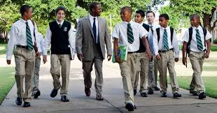
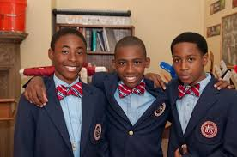
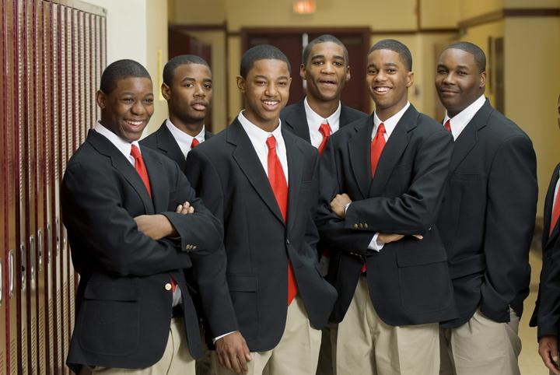
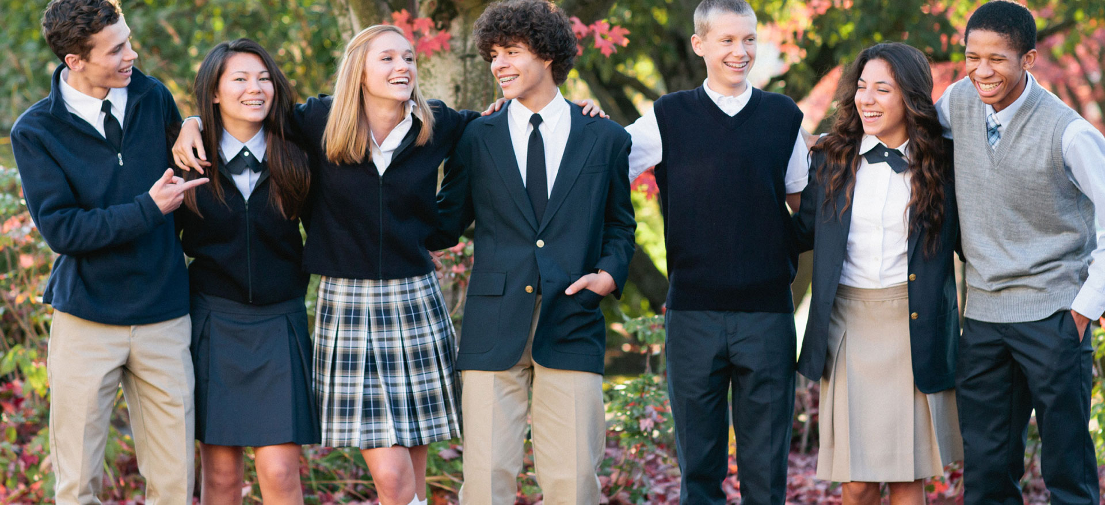
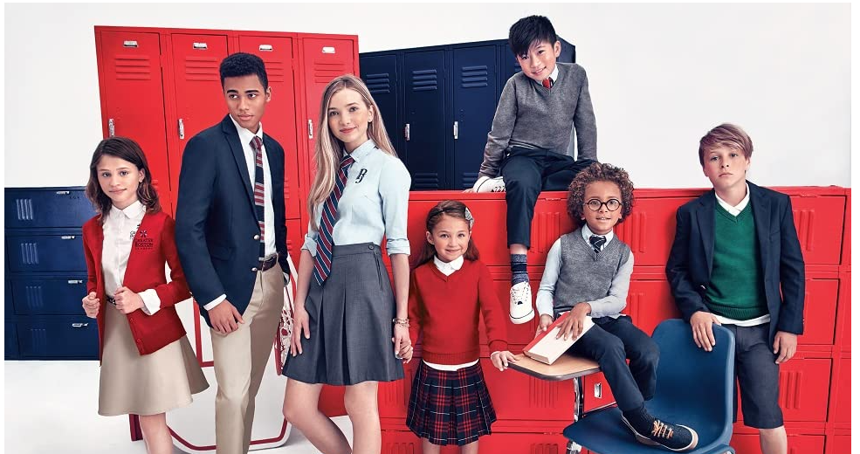
Students will be able to mix and match, to suit their style, CPA School Colors: burgundy, royal or navy blue and grey, white.

Slide 3
Weekly Attire
Monday (Professional Attire) – Blazer, slacks, skirt, white button front shirt, with or without vest depending on season and weather. Boys belt, tucked shirts, and all students’ shoes are black - No sneakers
Tuesday, Wednesday, Thursday (Casual Attire) – sweater, vest, slacks, skirts, jumpers, shorts and scoots/scorts, polo type shirts, sneakers all black or white (NO Crocks or colored shoes)
Friday (Dress Down Attire)- Blue or Grey Khaki/ Blue denims with CPA school t-shirt only, sweats with matching sweatshirt or school t-shirt, sneakers all black or white
Principal “Where What You Want Fridays” Fundraiser
July 13th to August 7th, 2022
Parents pre purchase “Where What You Want Fridays”
2 dollars for every school year Friday (36)
the entire year $72
or
every other Friday $36
To prevent any confusion, these Fridays must be purchased at the beginning of the school year. It is difficult to keep up with which students can, and cannot, it will be efficient to have list at the beginning of the year to avoid any confusion
No, No, No’s
No attire with any logos other than CPA
No crocs, sandals, colorful sneakers
No clothing with tares or skinny jeans
No other colors, except school colors
No colored socks, only black, grey, blue or burgundy
No hats or bandanas
No leggings as pants
No t-shirts, jackets, sweaters or pants with any type of logo or mantra
No mixed color clothing, only solid or plaid school colors
No colorful belts

Slide 4
CPA School Colors: burgundy, royal or navy blue and grey, white (front button short and polo shirts).
All clothing in this PowerPoint is found on Amazon

Slide 5
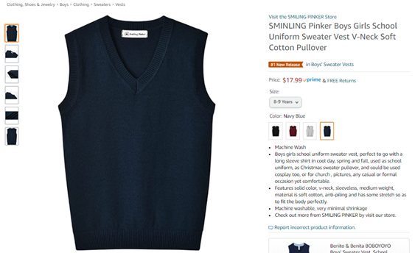
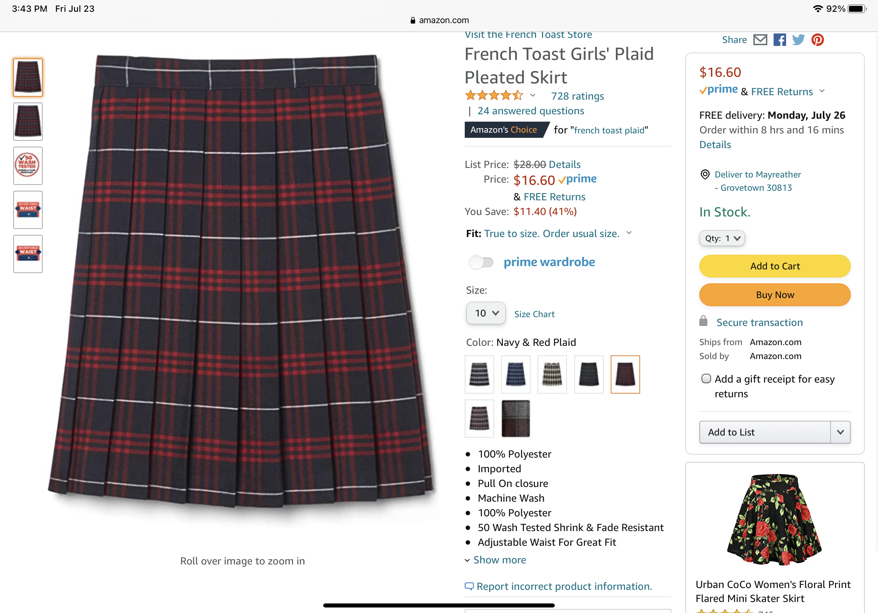
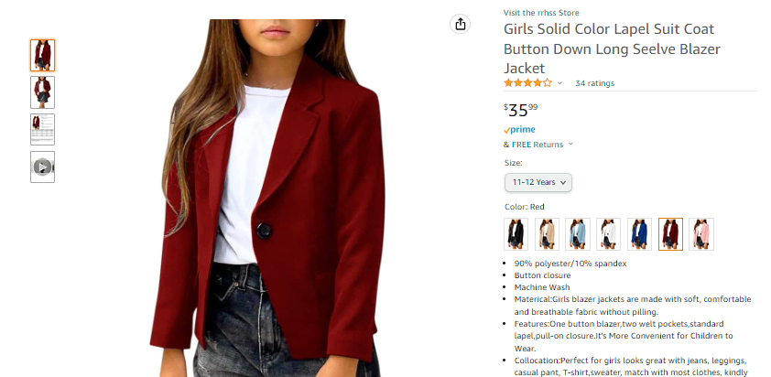
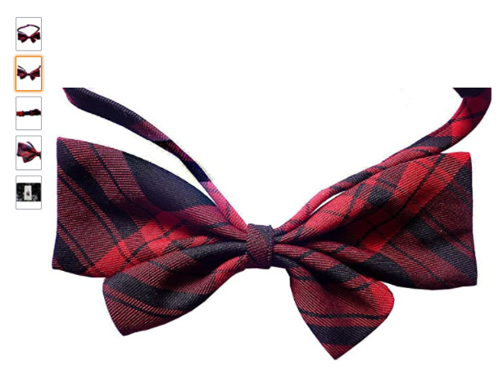
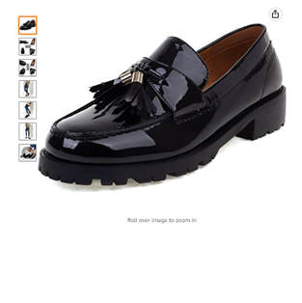
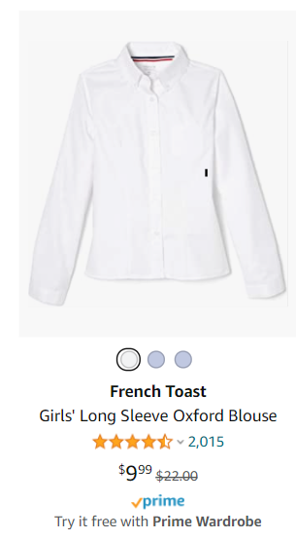
Professional Attire for Girls
These clothing are required Check List for Girls
Blazer (Burgundy/Red Blazer)
Sweater (navy Blue)
Vest (navy Blue)
Oxford button front shirt (white)
Bow tie (burgundy plaid)
Pleated Skirt (burgundy plaid)
Knee high socks (navy blue)
Loafers/Mary Janes (Black)

Slide 6
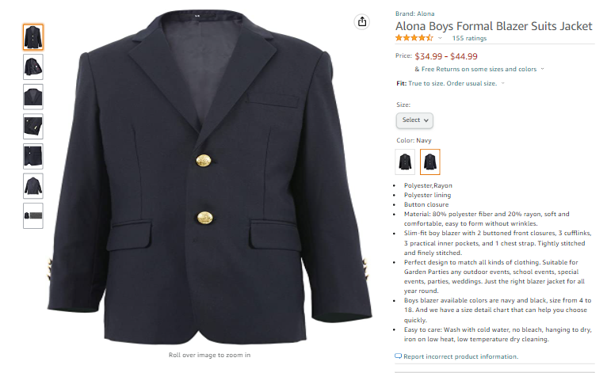
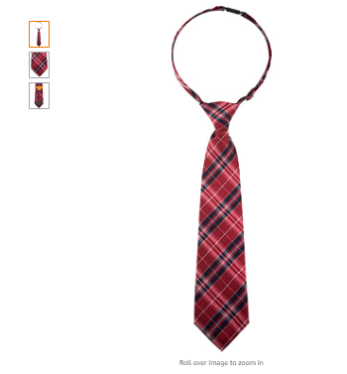
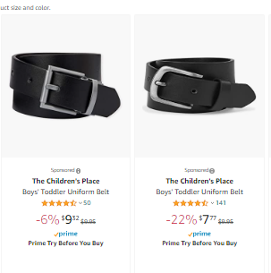
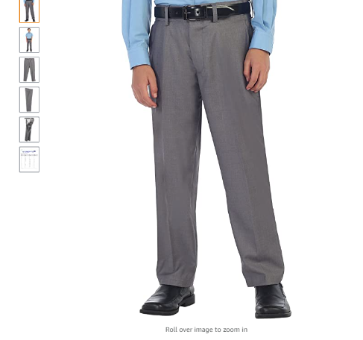
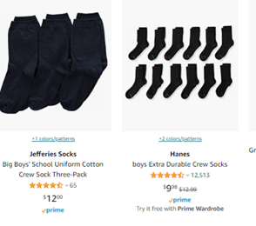
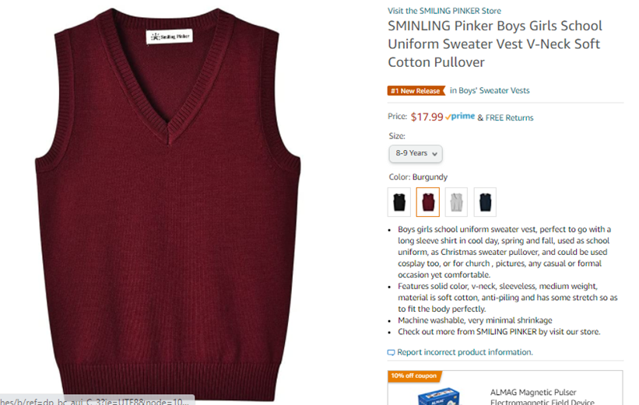
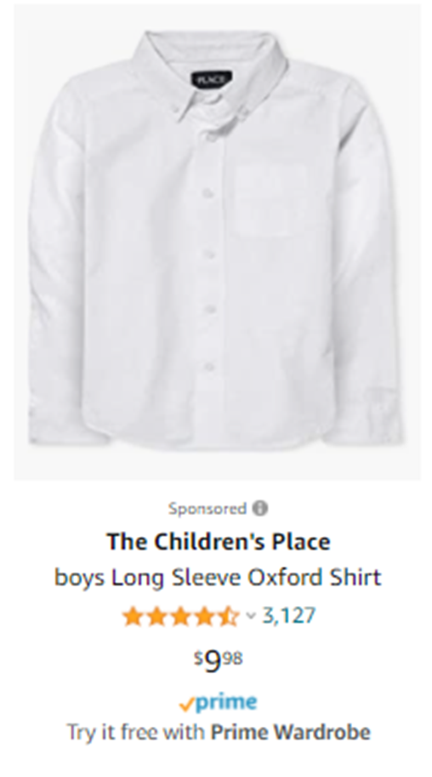
Professional Attire for Boys
These clothing are required Check List for Boys
Blazer (Navy Blue Blazer)
Sweater (burgundy Blue)
Vest (burgundy Blue)
Oxford button front shirt (white)
Bow tie (burgundy plaid)
Slacks (navy blue)
Socks (navy blue)
Loafers (Black)

Slide 7
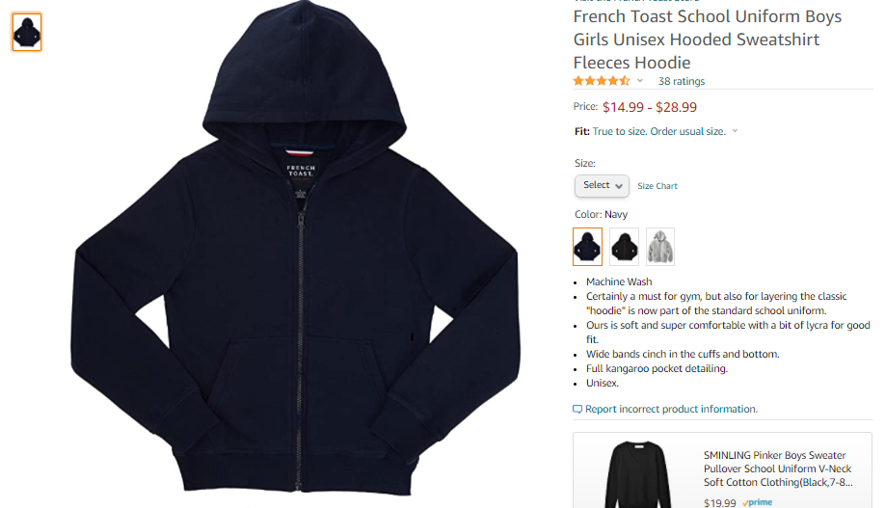
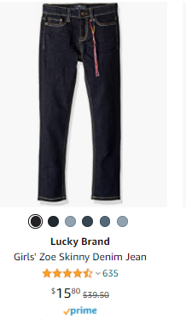
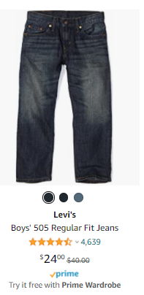
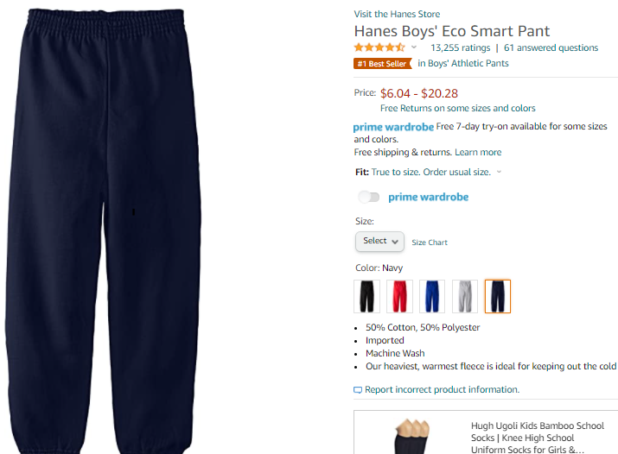
Dress Down Uniform
Khaki and Blue Denims (NO black, or any other color) can be worn with school T-Shirts. No torn or skinny jeans. If a student participates in “Where What You Want Fridays” they can wear different jeans of any color, and torn jeans THAT can not revel and skin, this includes skinny jeans.
Can be either, navy blue, burgundy or grey. Yes, students can mix and match colors.

Slide 8
Just Girls Causal Attire
Only clothing on this list can be worn,
mixing and matching is encouraged

Slide 9
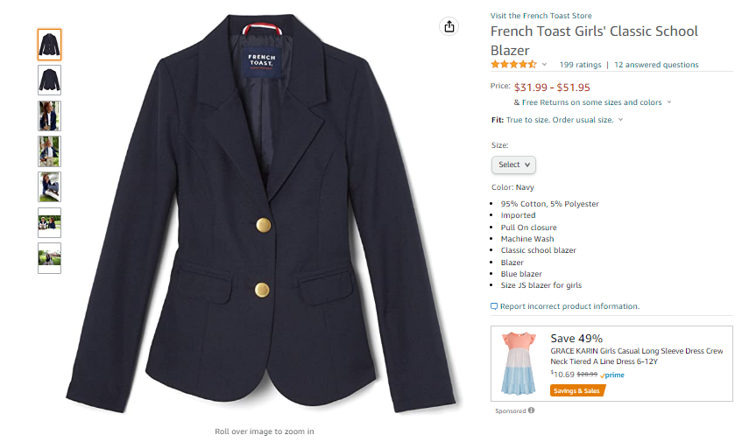
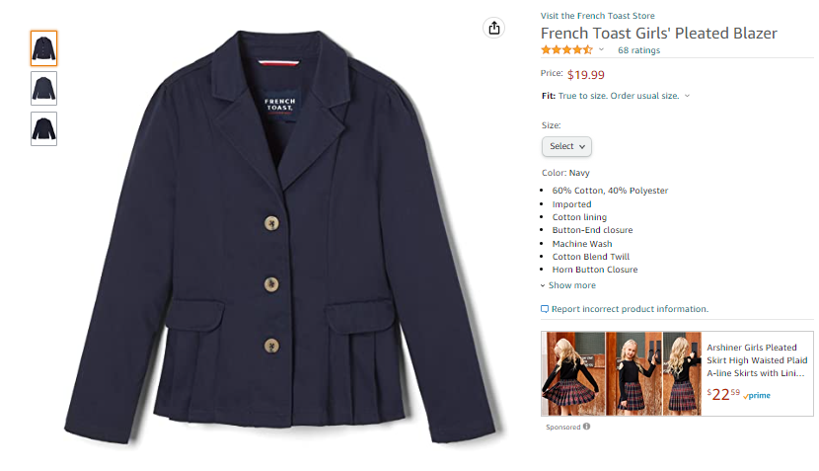
School Blazers
for Girls
This jacket is required

Slide 10
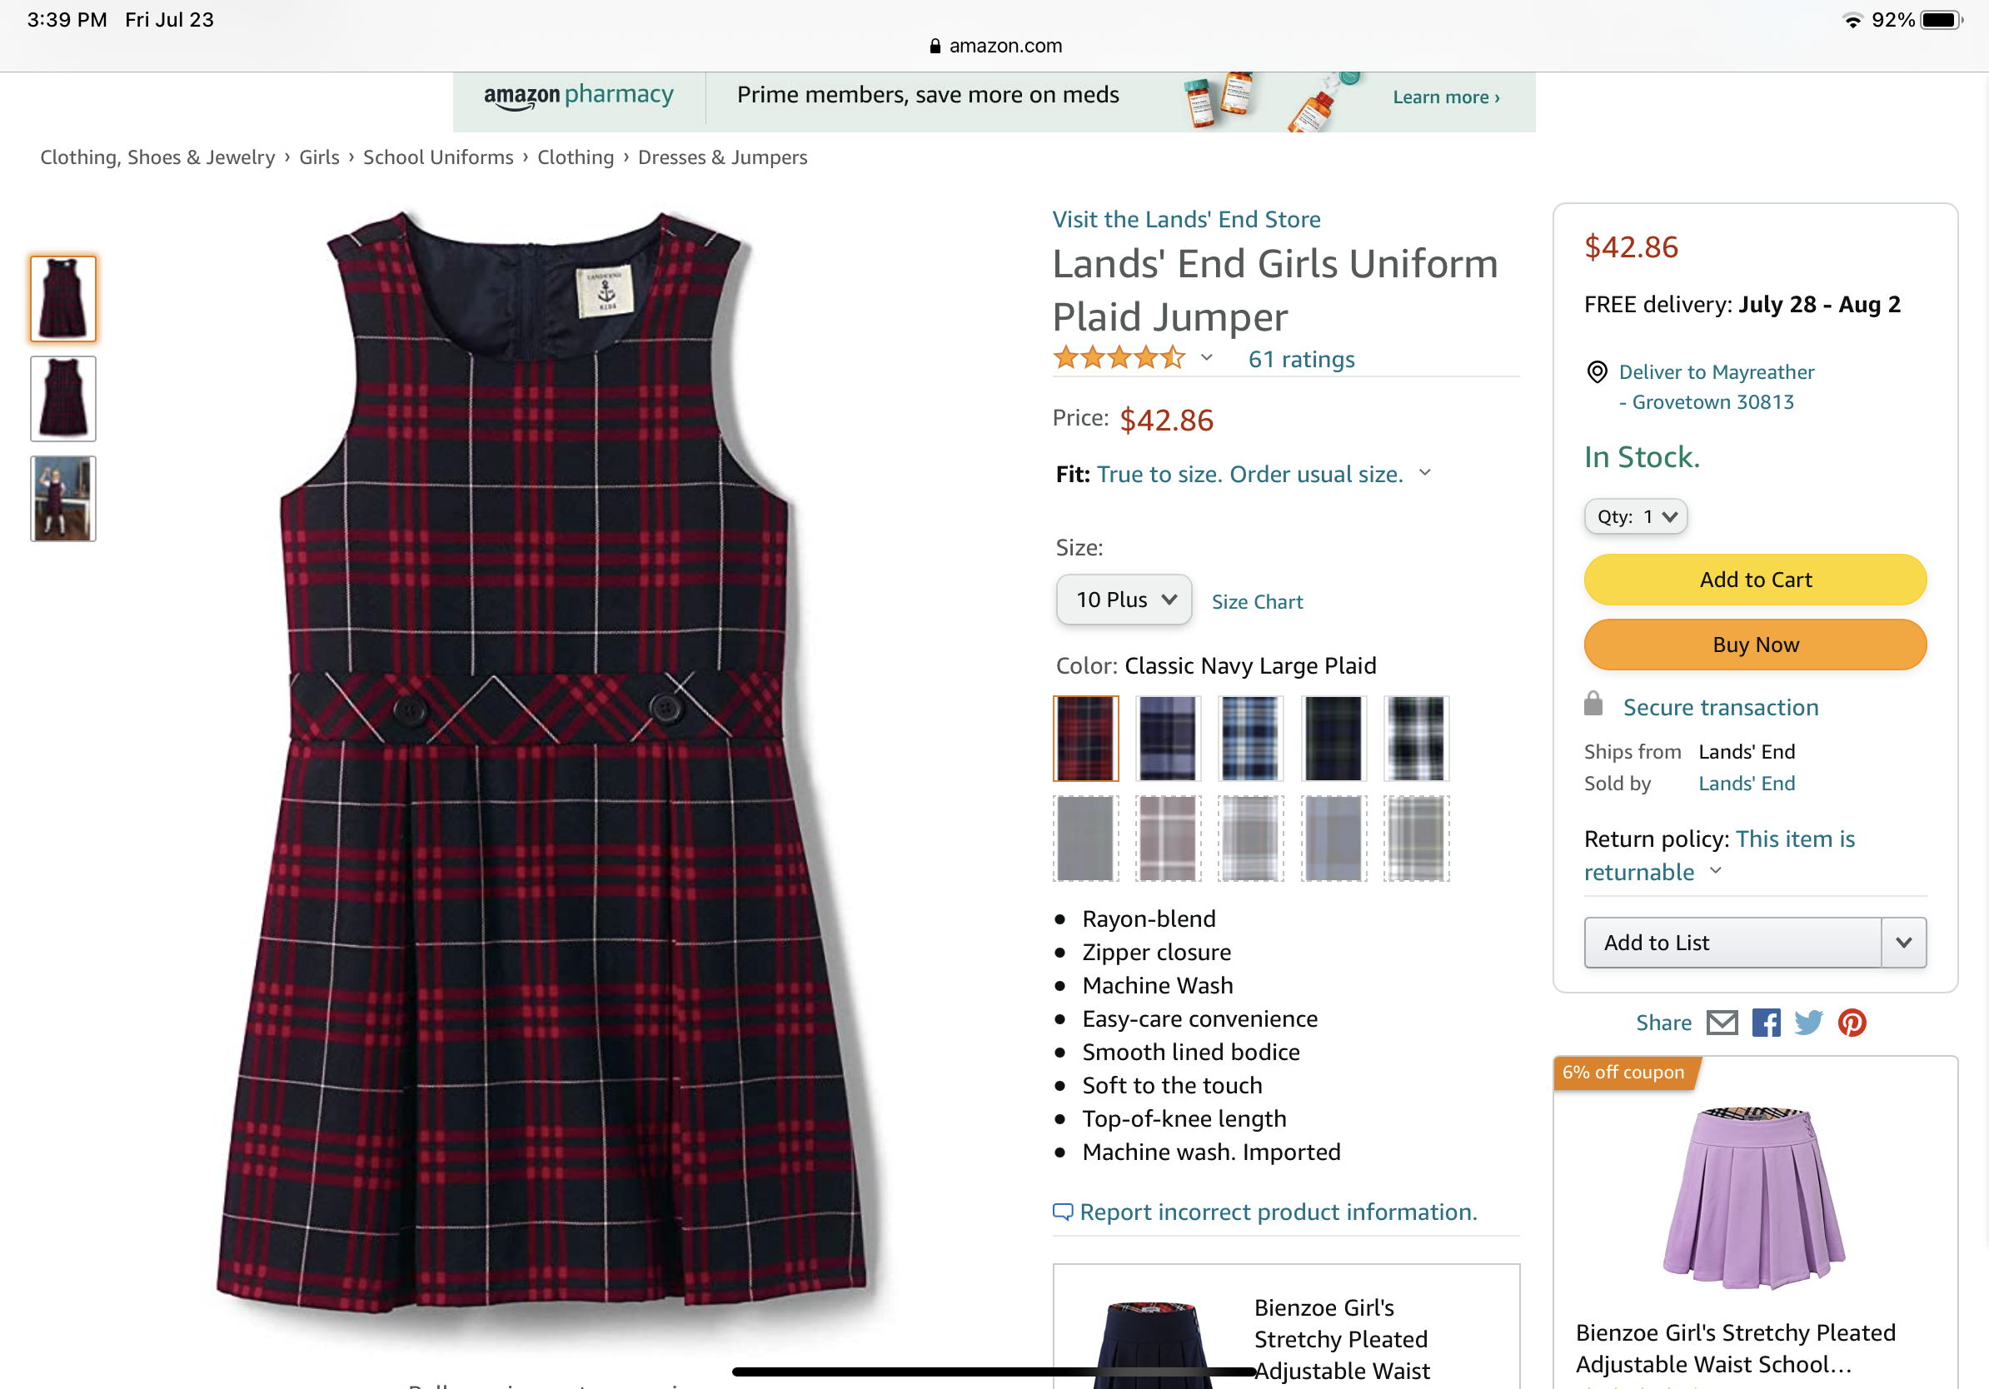
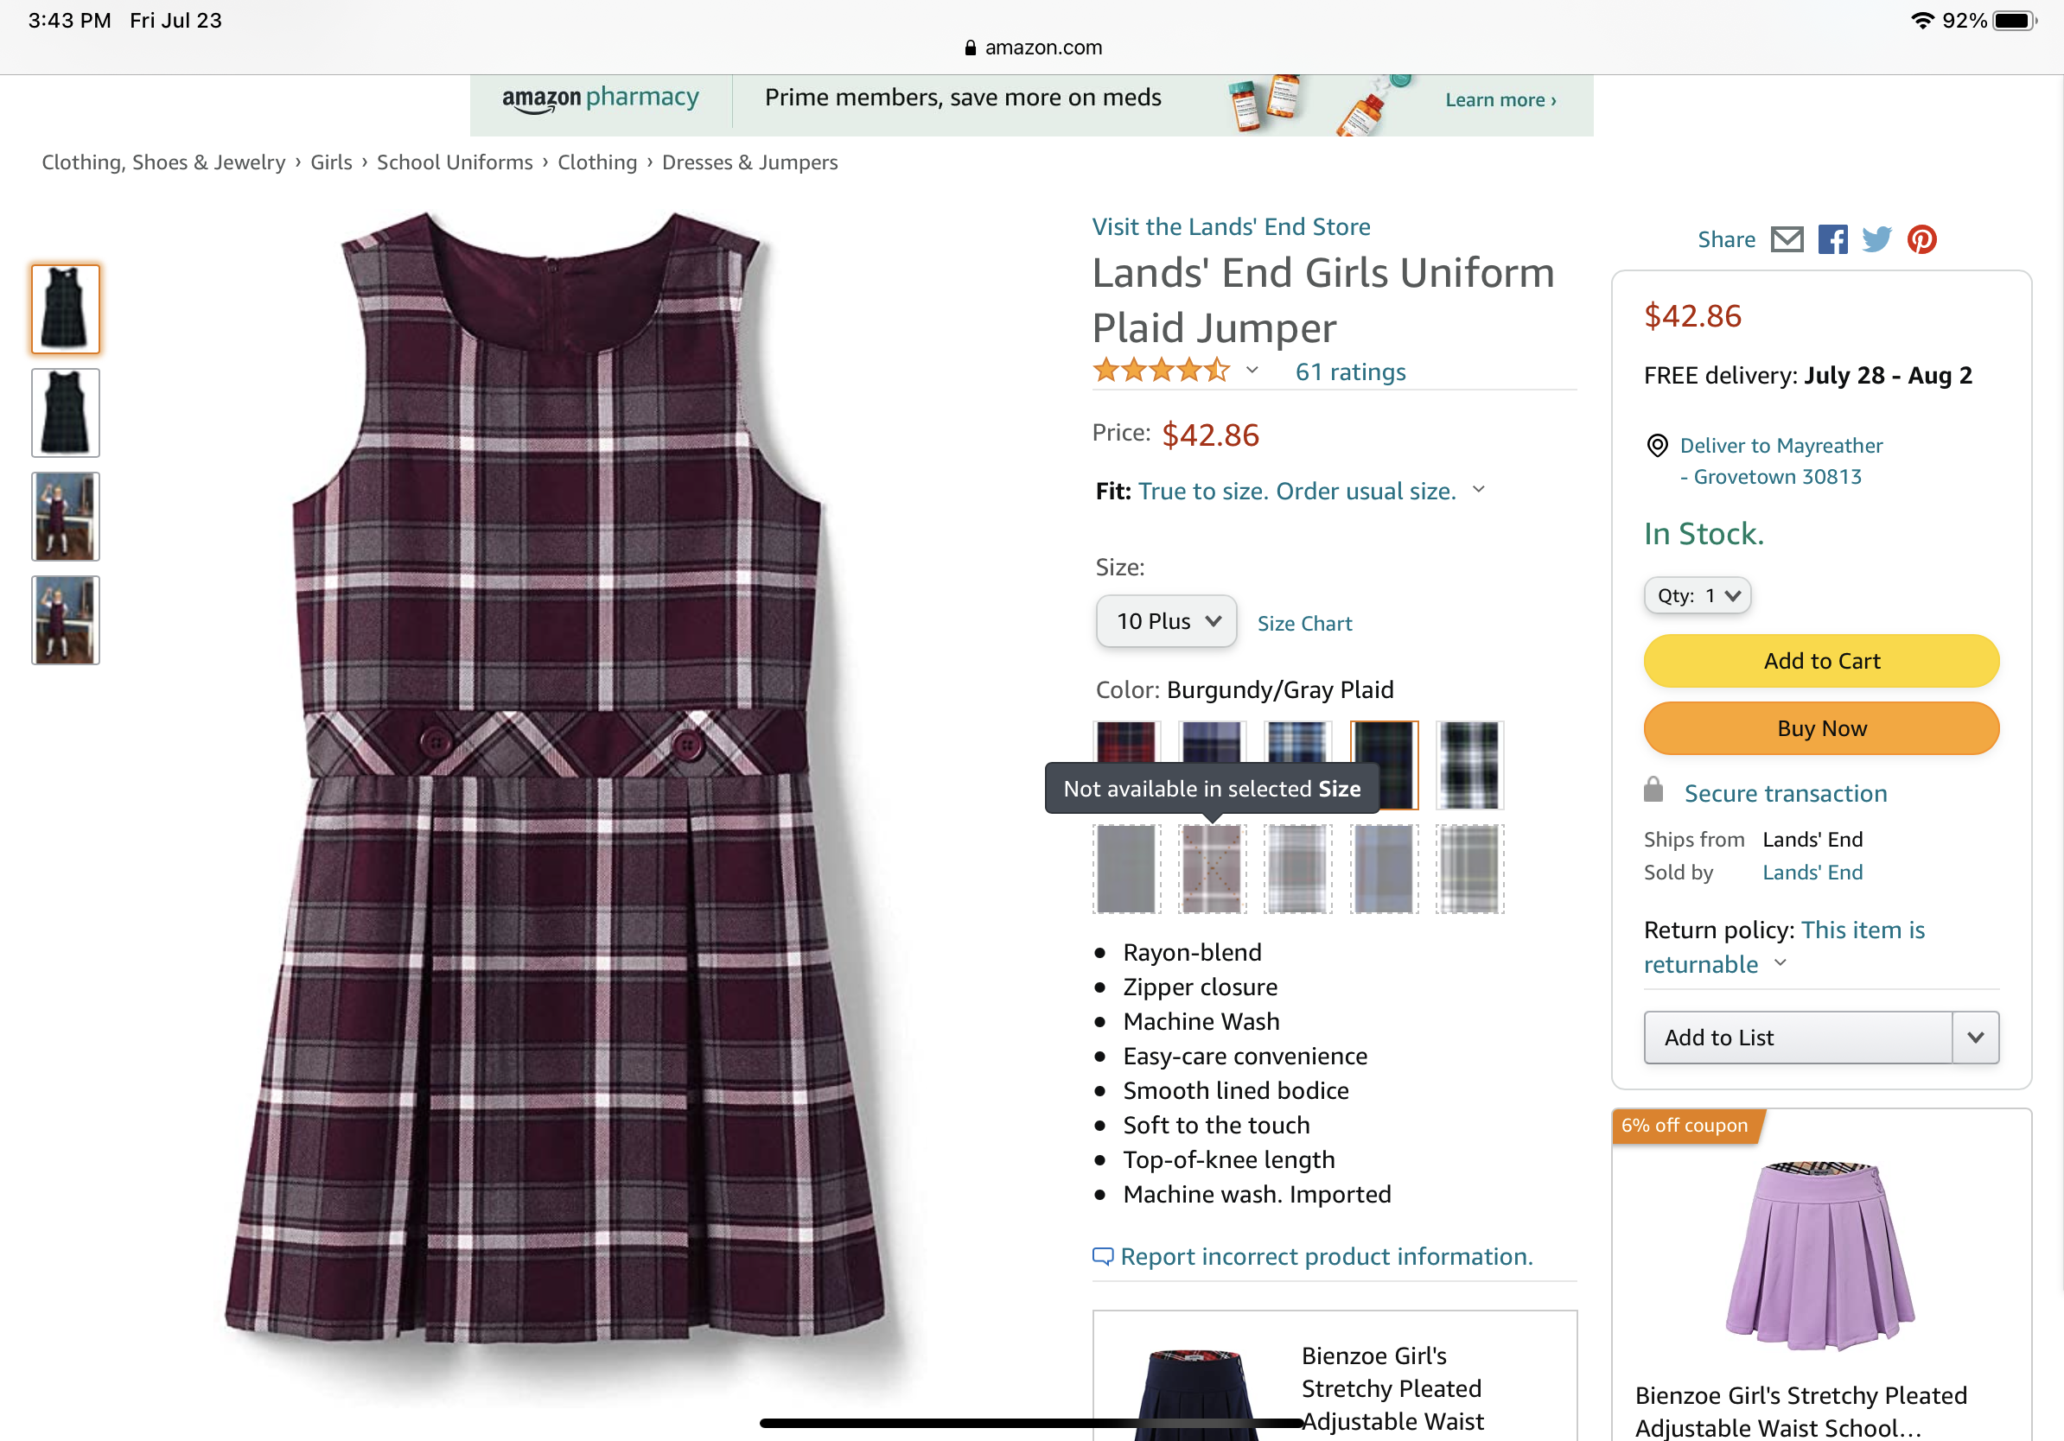
This plaid skirt is required

Slide 11
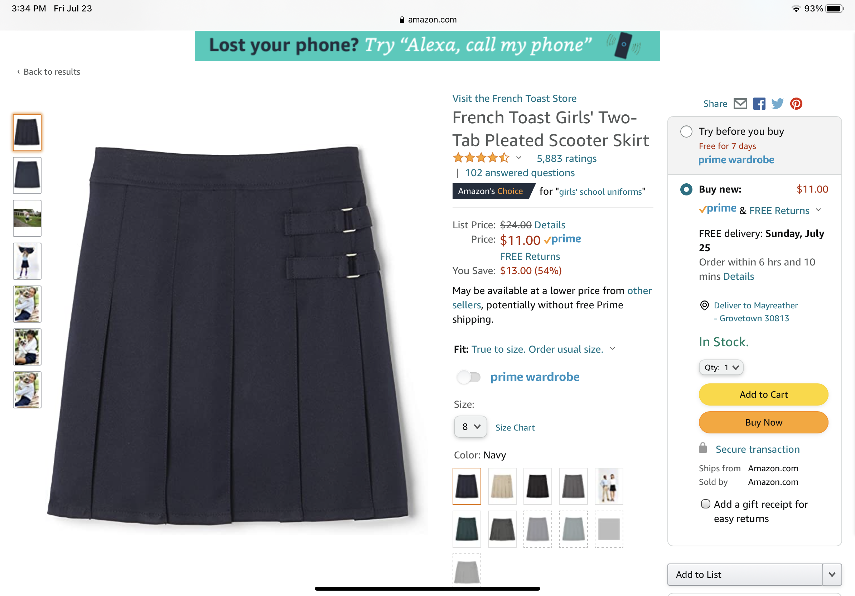
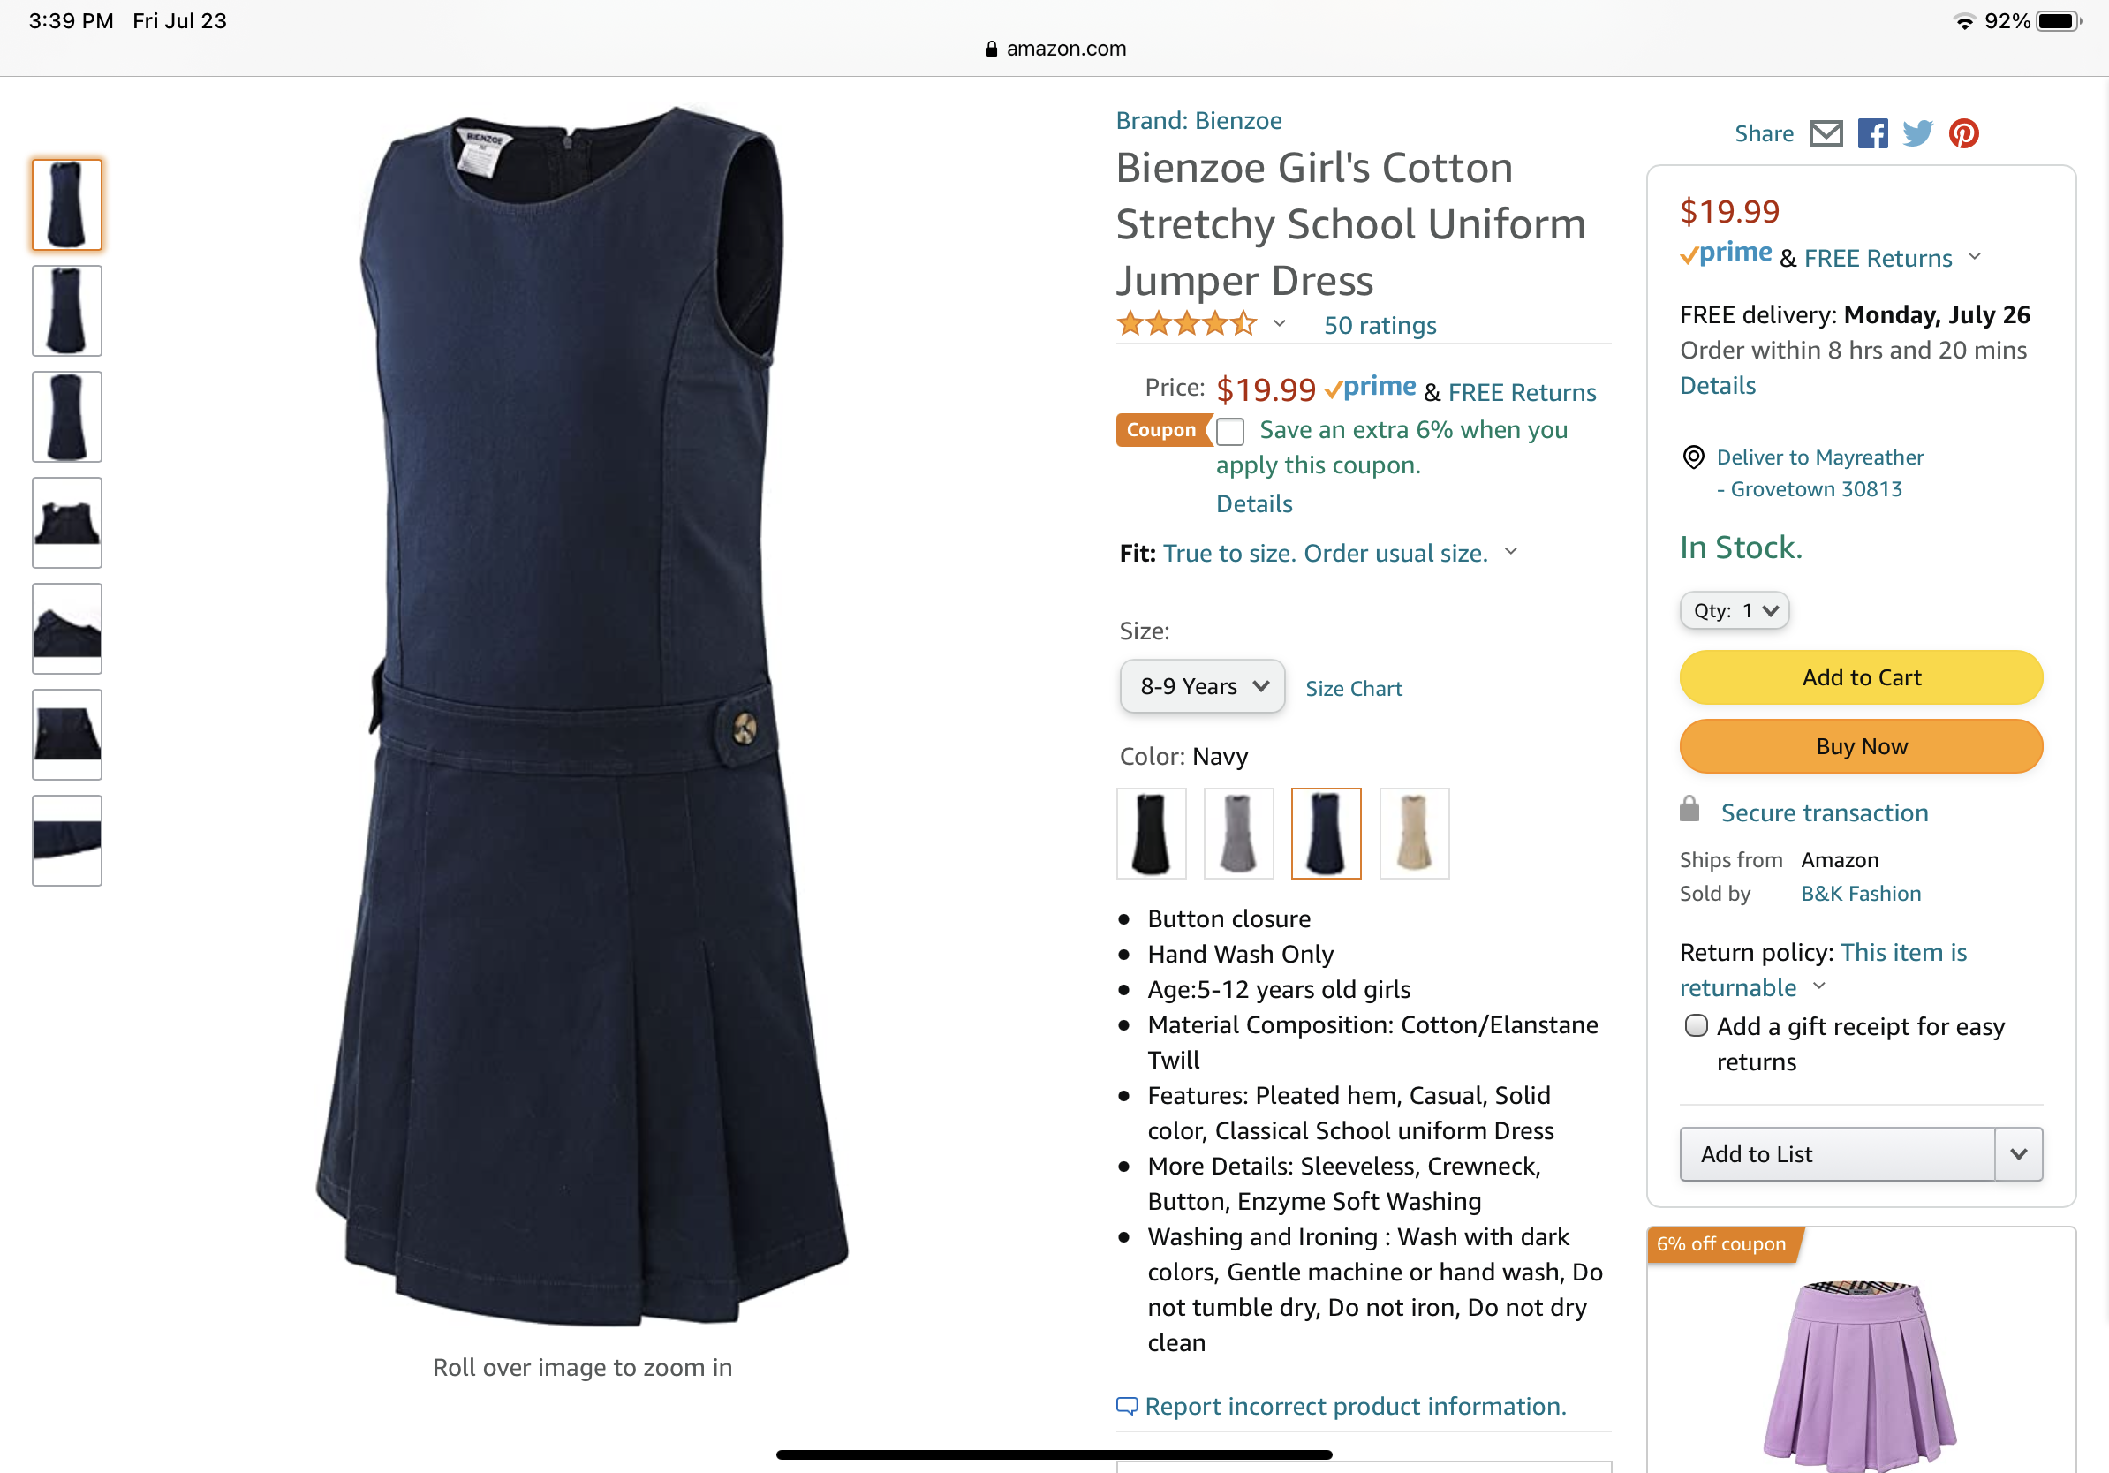
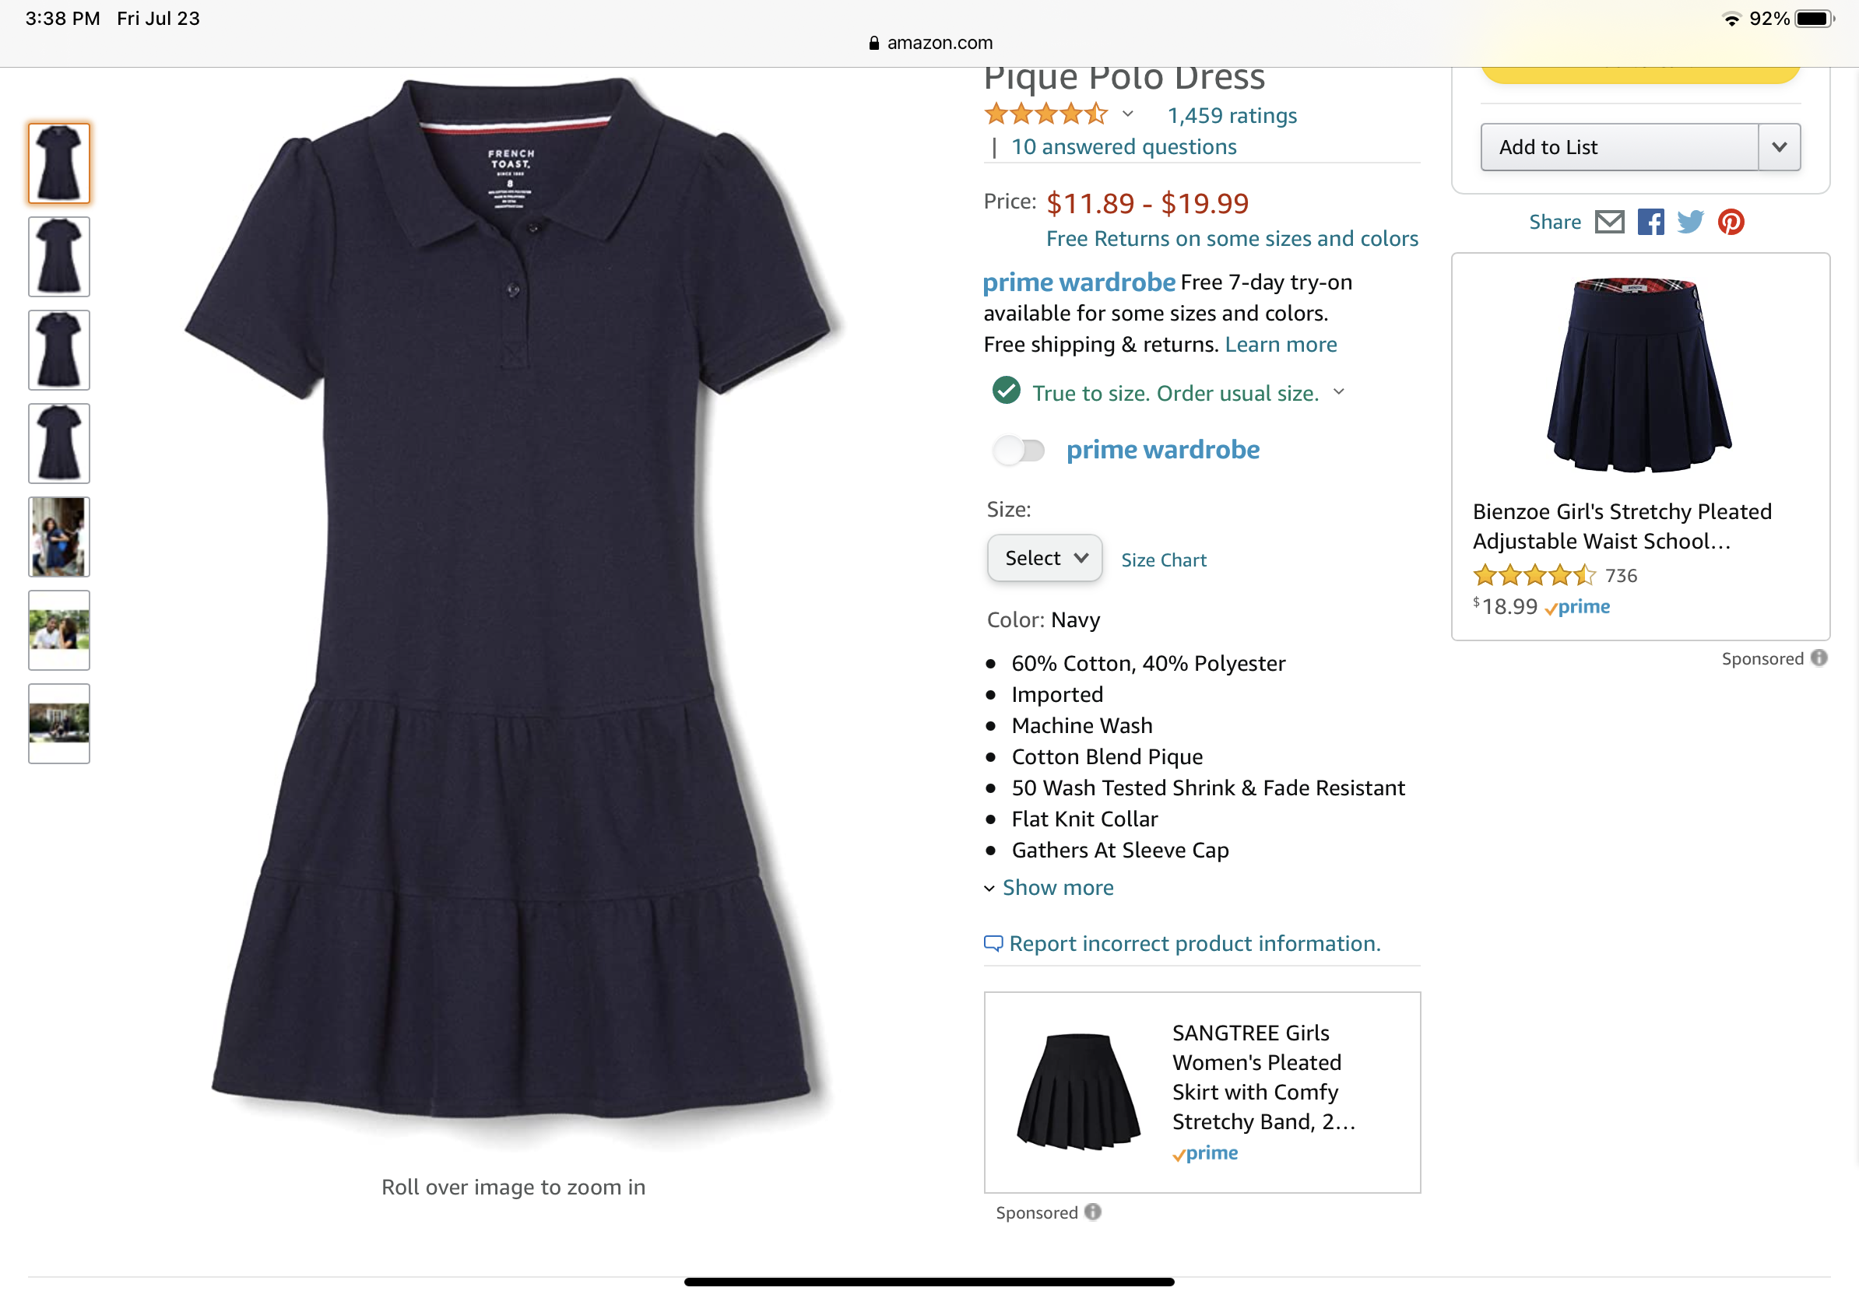
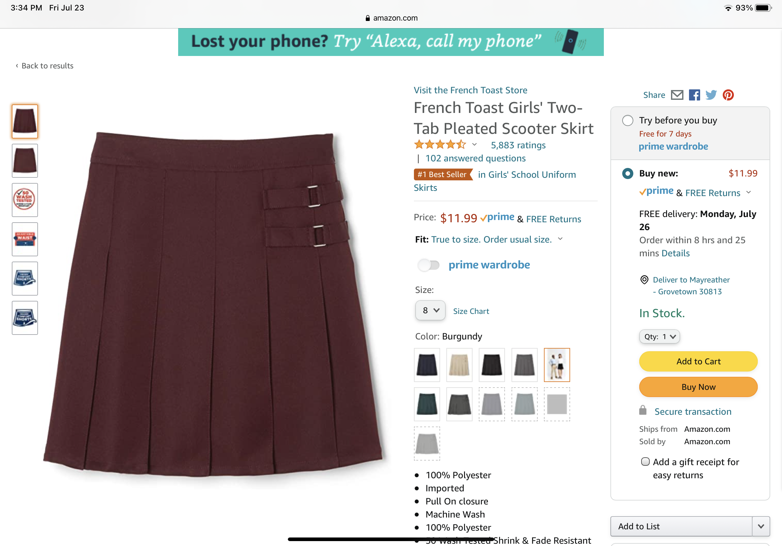
Casual Uniform
All can be either, navy blue, burgundy or grey. Yes, students can mix and match colors.

Slide 12
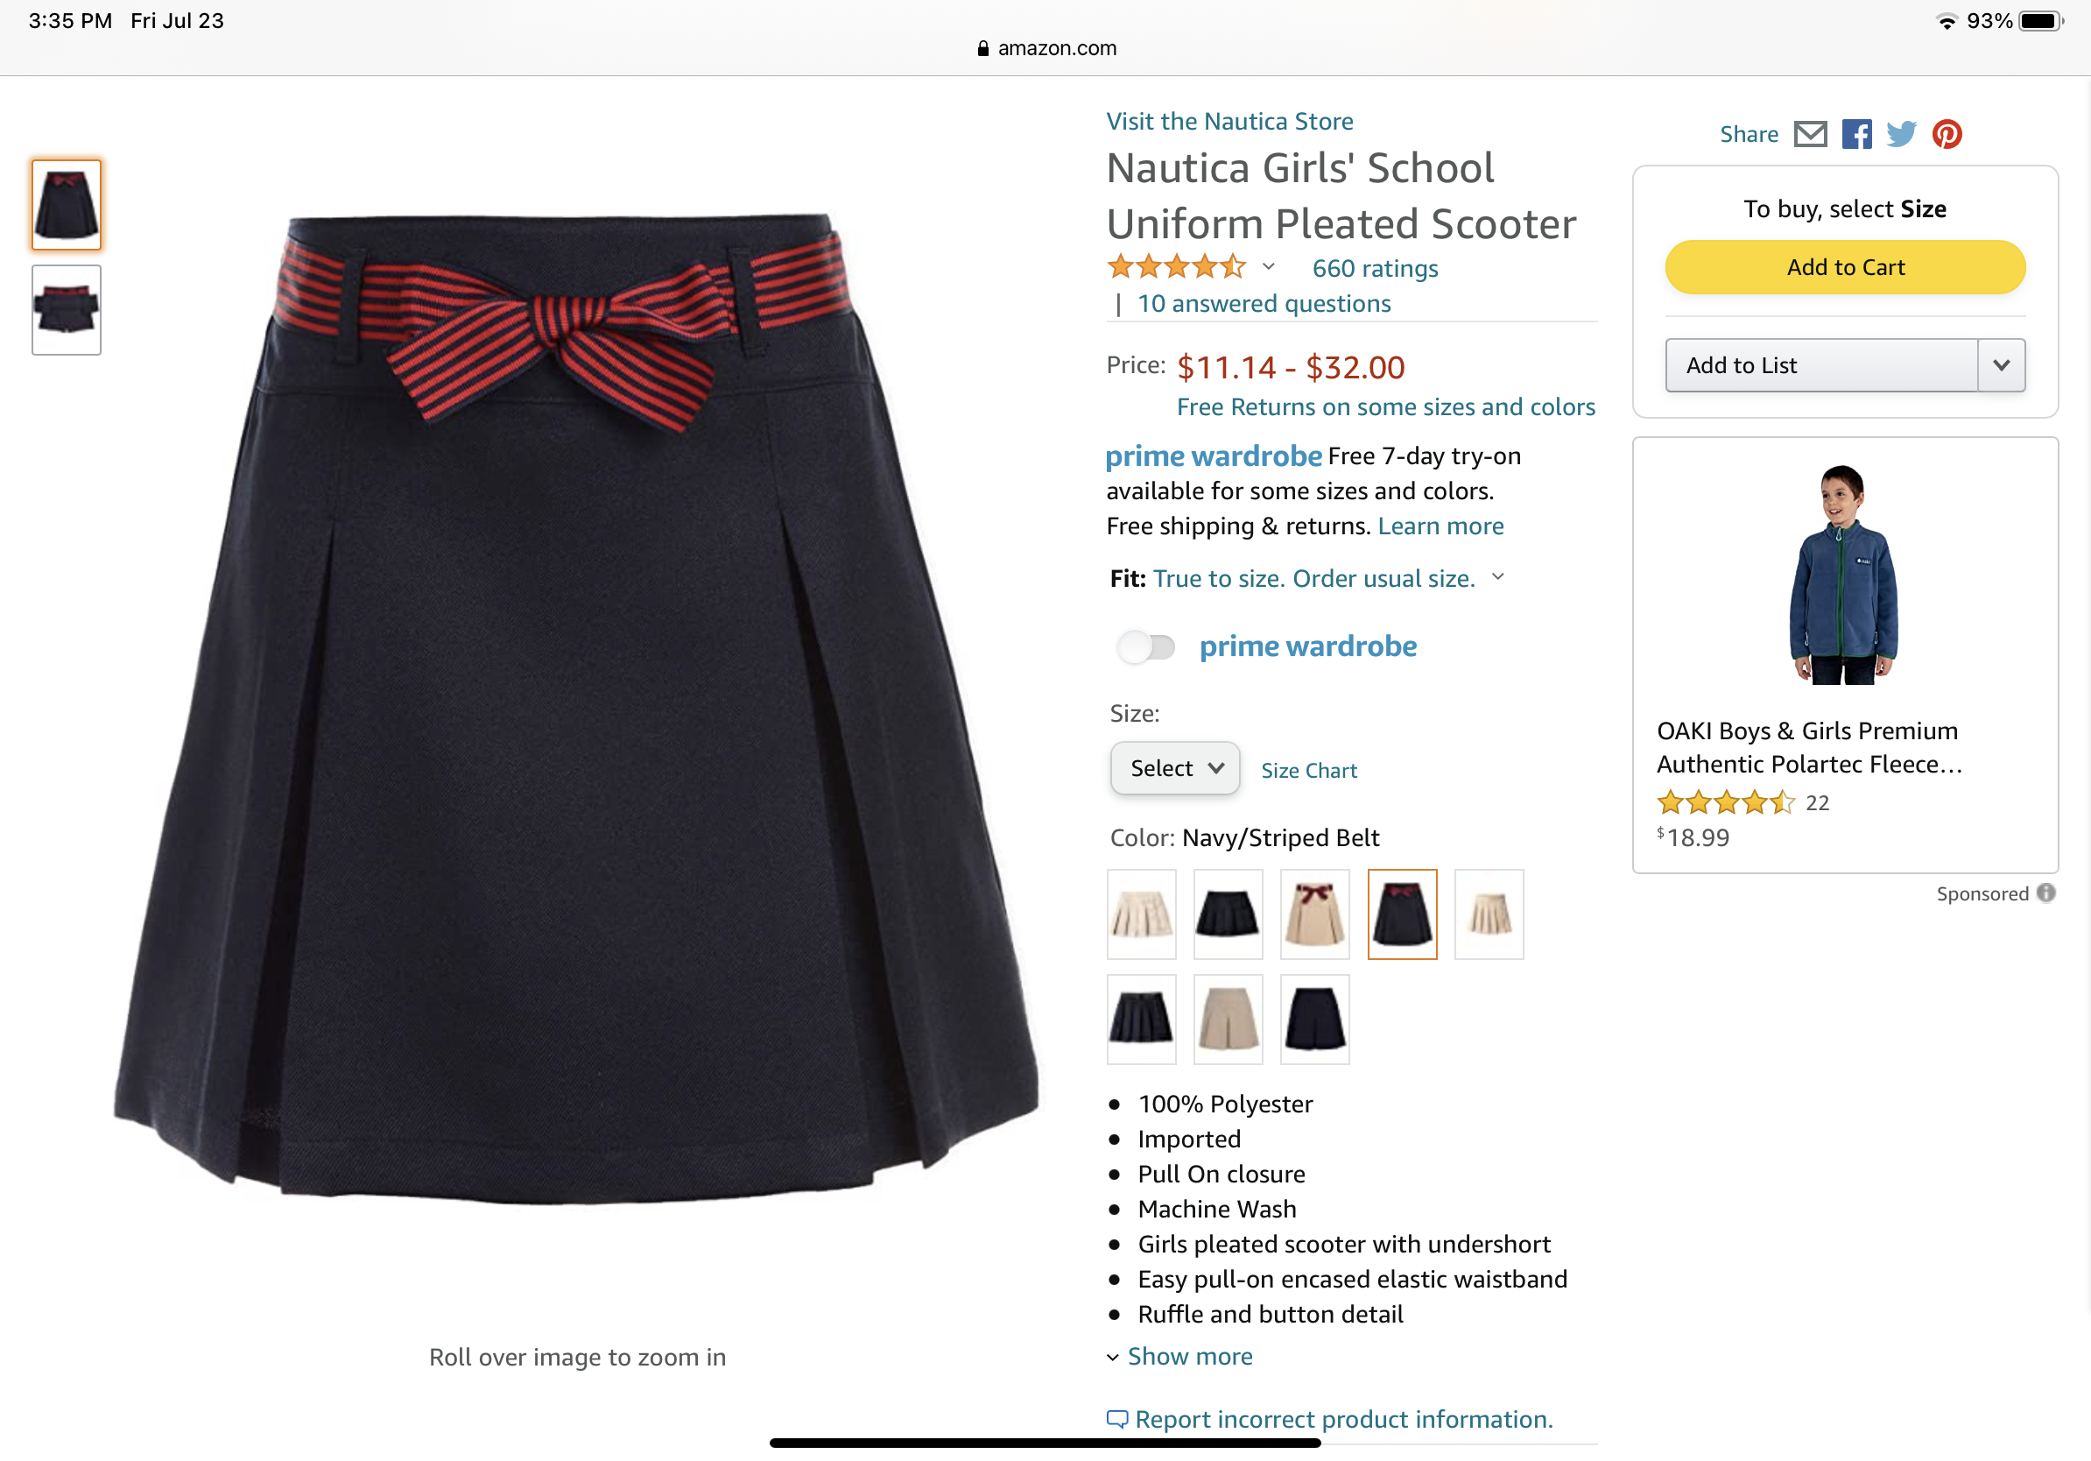
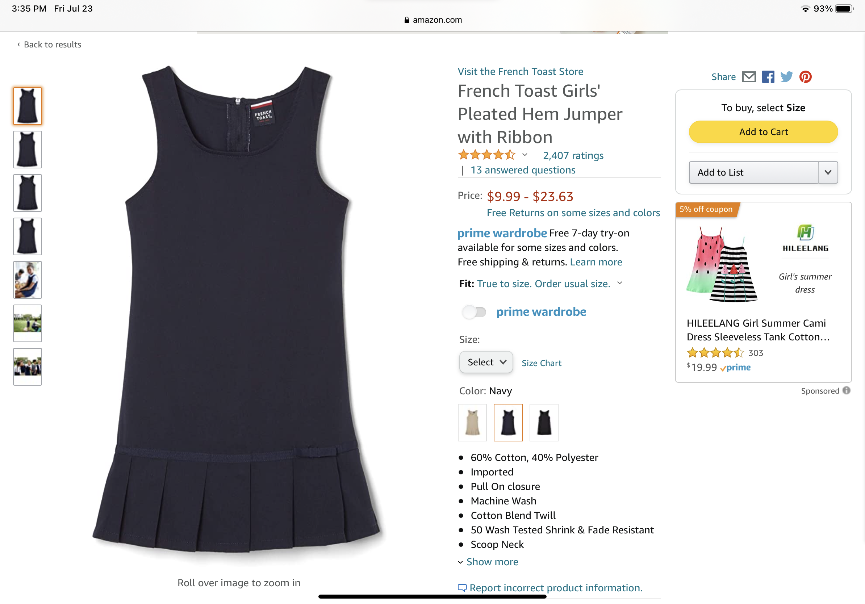
All can be either, navy blue, burgundy or grey. Yes, students can mix and match colors.

Slide 13
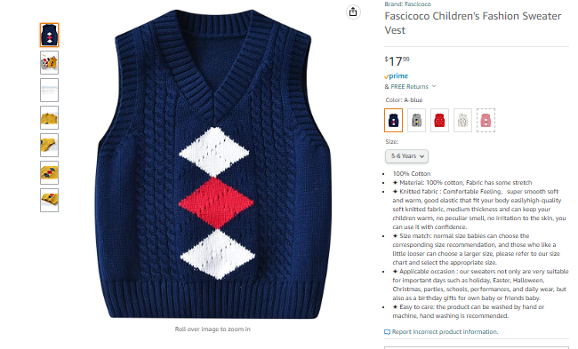
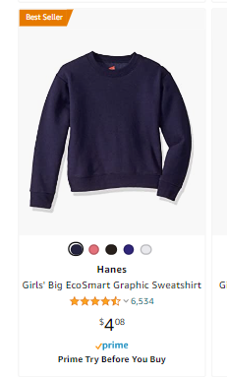
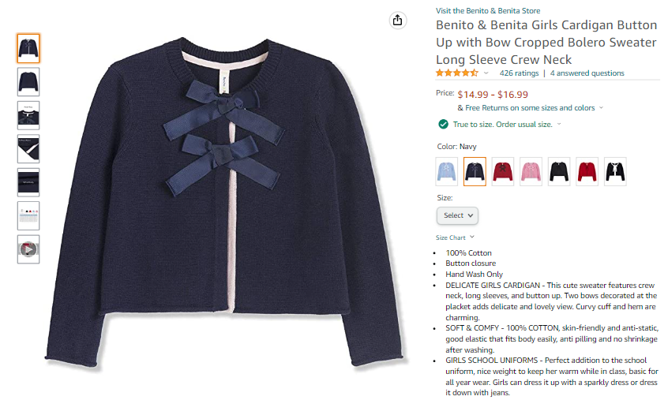
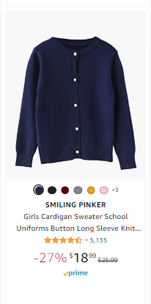

Slide 14
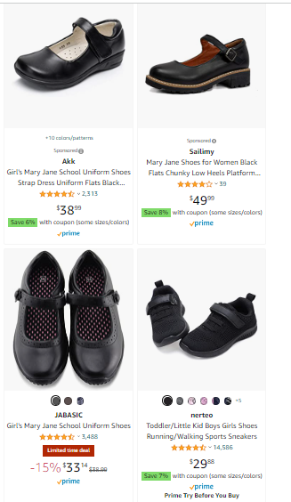
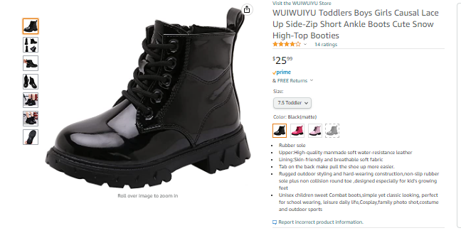
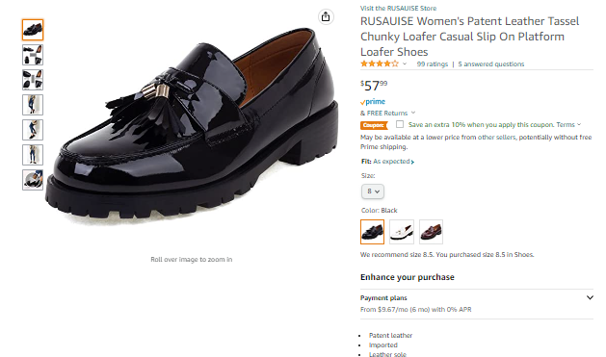
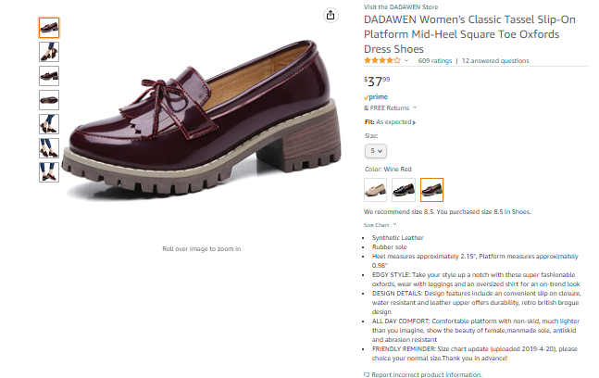
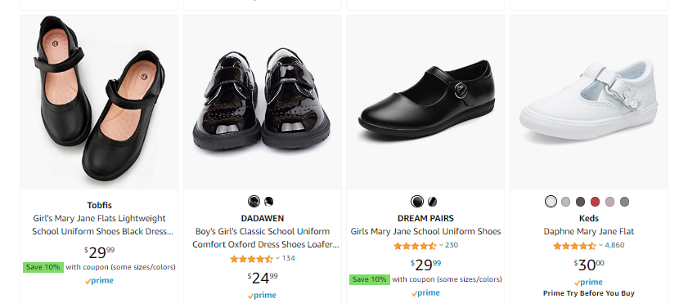
Shoes for Girls, select from this type only
Loafers, Mary Janes and Shooties (colors = black or burgundy)

Slide 15
Just Boys Casual Attire
Only clothing on this list can be worn,
mixing and matching is encouraged

Slide 16
All can be either, navy blue, burgundy or grey. Yes, students can mix and match colors.

Slide 17
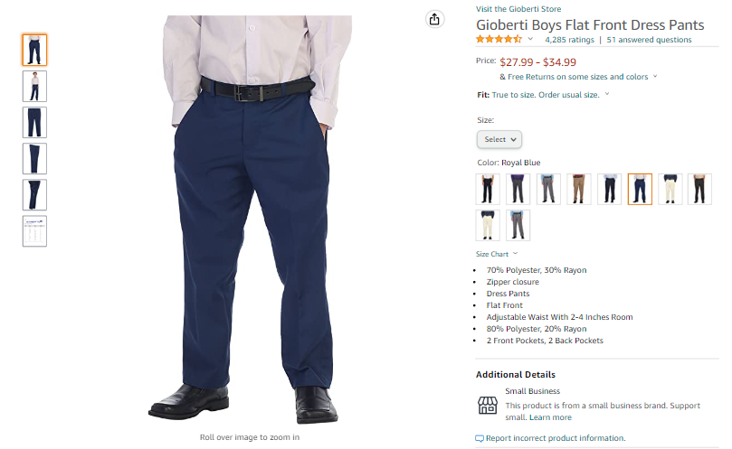
These two colors (grey and royal blue), slacks are required for boys

Slide 18
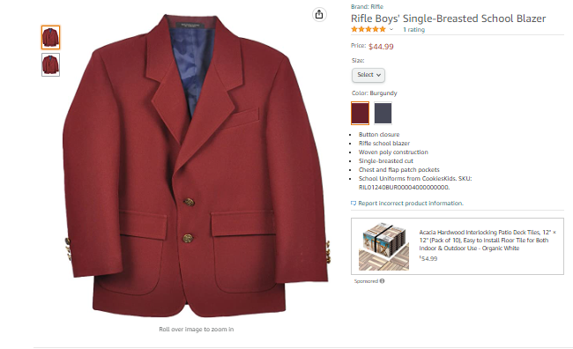

Slide 19
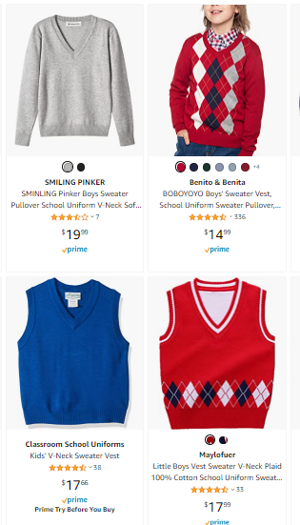

Slide 20
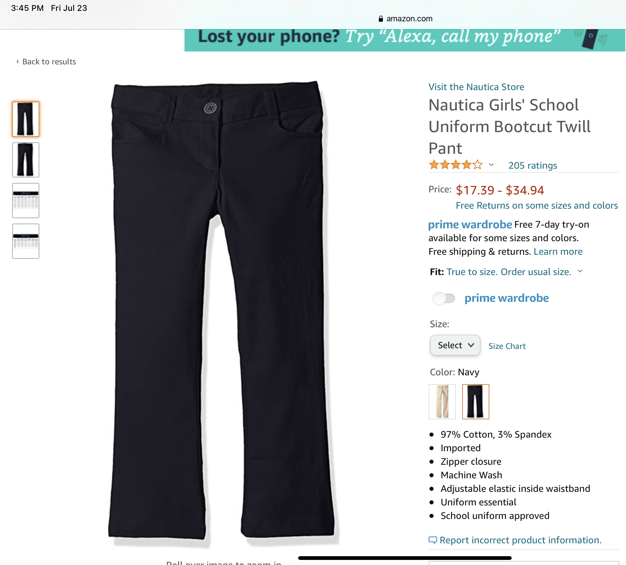
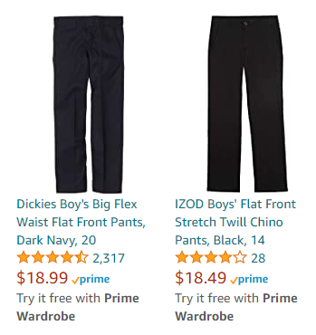
All can be either, navy blue, burgundy or grey. Yes, students can mix and match colors.

Slide 21
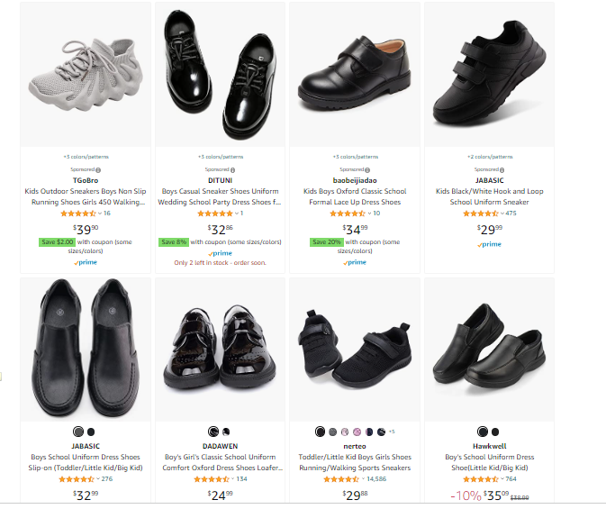
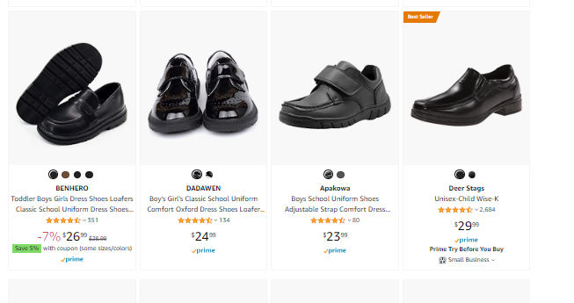
Shoes for Boys, select from this type only

Slide 22
These slides have Casual Attire
For Boys & Girls
Mixing and Matching is encouraged

Slide 23
These shirts are required
I recommend 2-3 shirts

Slide 24
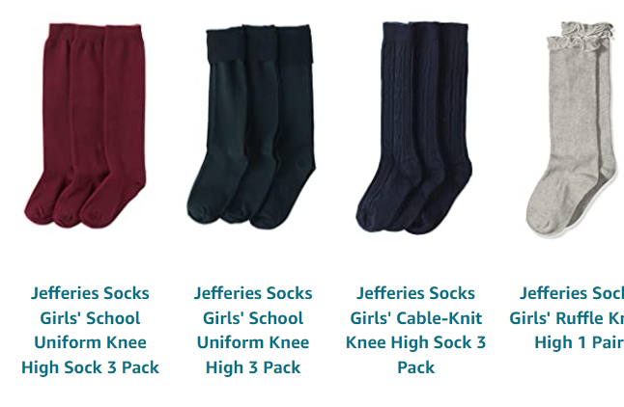
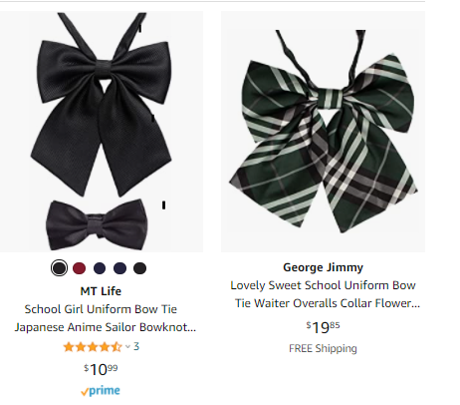
Uniform Accessories
Girls, along with boys must select at least one tie (bow tie). The only criteria is that it reflects school colors – burgundy and/or blue or a plaid mix. Socks are solid. Footwear is black and should compliment clothing. Also, there are some shoes that are burgundy or dark blue which is acceptable to wear only on T/W/T
Students must wear a black belt.

Slide 25
All can be either, navy blue, burgundy or grey. Yes, students can mix and match colors.

Slide 26
Formal/Ceremonial Uniform
This burgundy vest is required for boys
This blue vest is required for girls
All can be either, navy blue, burgundy or grey. Yes, students can mix and match colors.

Slide 27
All can be either, navy blue, burgundy or grey. Yes, students can mix and match colors.

